Slide 1


Enhance Smart Home capabilities by learning from usage patterns and IoT devices José Alexandre Da Silva Mirra
Supervised by: Cesar Analide and Fábio Silva December 2018

Slide 2
Content
Introduction
Our Approach
Case Study
Conclusion
Future work

Slide 3

Introduction

Slide 4
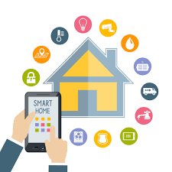
Smart Home
Smart Home is defined as a living or working space that interacts in a natural way and adapts to the occupant.
Smart Homes are environments that automate action and adapt themselves to user behaviors.
Dixit and Naik (2014)
Notes:
SMART HOME TEM DIVERSAS VANTAGENS.
SMART HOME -> Ambientes Inteligentes!
Dar ênfase FEEDBACK utilizador.

Slide 5
Objectives and Challenges
The purpose of this work is to develop a system capable of taking the best action possible based on its environment.
There are some impasses regarding the social embrace of this technology, being loss of control and apathy one of the main concerns. Balta-Ozkan et al. (2013)
Non intrusive system to the user. User must be able to control the data collected and used.
Notes:
SMART HOME TEM DIVERSAS VANTAGENS.
Dar ênfase FEEDBACK utilizador.
According to Balta-Ozkan et al. (2013) (loss of control and apathy)

Slide 6
Related Work
Existing projects towards Smart Homes use mostly a pattern mining technique to determine what can be the next action. (Supervised Learning, not focused in user feedback)
More recently, Gokul et al. (2016) present the ﬁrst deep reinforcement learning model for home automation system. However, the lack of user intervention leads to system without user feedback, in this way, the feeling of control is not maintain.
Our approach aims to avoid these social barriers.
Notes:
SMART HOME TEM DIVERSAS VANTAGENS.
Dar enfase FEEDBACK utilizador.
MavHome project by Cook et al. (2003), an home that acts as a rational agent which aims to maximizes comfort and productivity of its inhabitants and
minimizes operation cost. In order to achieve this goals, the house must be able to predict,
reason about, and adapt to its inhabitants.

Slide 7

Our Approach

Slide 8
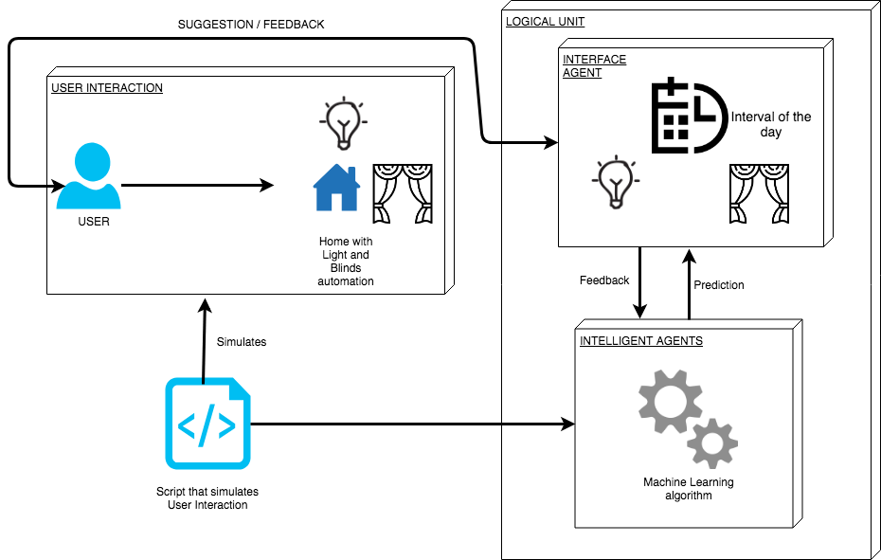
Architecture

Slide 9

Reinforcement Learning
Reinforcement learning is learning what to do, how to map situations to actions, so as to maximize a numerical reward signal.
The agents will be trained by the actions taken in the environment, and receiving positive or negative rewards.
Notes:
Possivel soluçao! AGENTE PERCEBE O AMBIENTE E ATUA SOBRE ELE (smart Environment).
Este agente inteligente Percebe o meio que o rodeia e usa informação presente para tomada de decisao (Machine Learning)
Este Agente sera inteligente (MACHINE LEARNING PARA APOIAR A DECISAO)

Slide 10
Approach
Tensorﬂow deep reinforcement learning approach, using a gradient policy neural network.
With the aid of the neural network, the agent will choose the action that corresponds to the largest expected value, predicting the best action to take in that instance.
loss =−log(π)∗A
Notes:
Intuitively, this loss function allows us to increase the weight for actions that yielded a positive reward, and decrease them for actions that yielded a negative reward. In this way the agent will be more or less likely to pick that action in the future
A is advantage,and is an essential aspect of all reinforcement learning algorithms. It corresponds to how much better the agent action was than the baseline, being 0.
The parameter π is our policy. In this case, it corresponds to the chosen interval weight.
(GRADIENT POLICY NETWORK)
Each interval has a weight for a determined action.
After each iteration,
the network is updated with the respective reward for that interval. In this way, we choose
the interval with the highest weight, corresponding to the policy prediction.

Slide 11
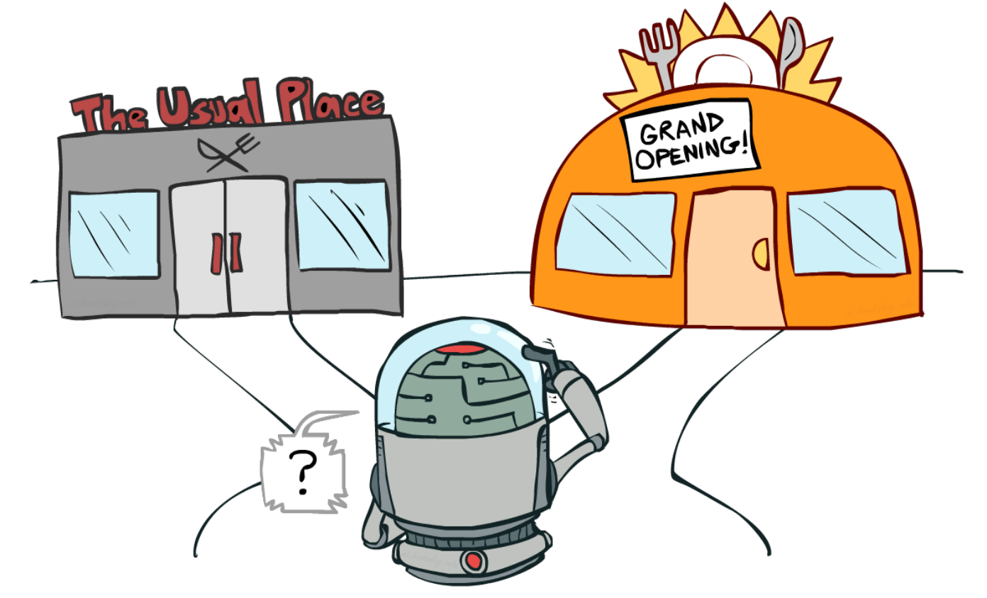
Approach
The crux of the problem is to balance :
exploration, which helps us learn about which states are good,
exploitation, where we now use what we know to pick the best interval for each action.
Notes:
The crux of the problem is to balance exploration, which helps us learn about which states are good, and exploitation, where we now use what we know to pick the best interval for each action.
To encourage exploration, we use epsilon greedy, which consists of taking a random action with probability epsilon.

Slide 12
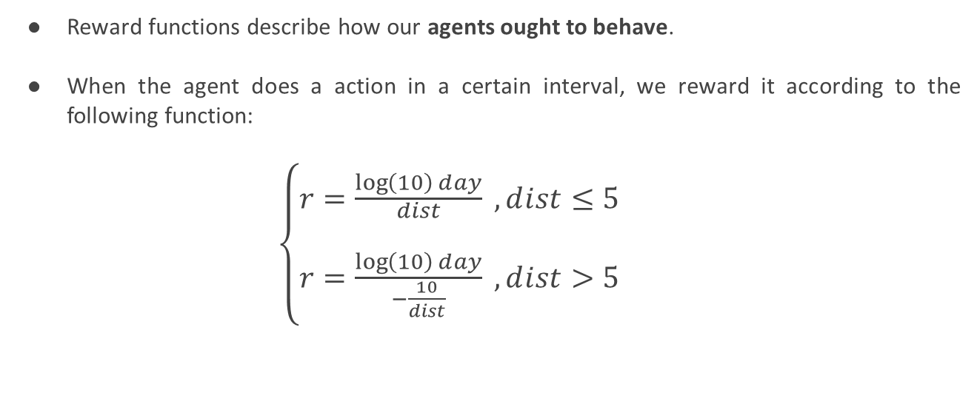
Reward Functions
Reward functions describe how our agents ought to behave.
When the agent does a action in a certain interval, we reward it according to the following function:
$\left\{\begin{matrix}r=\frac{\log\left(10\right)ⅆay}{\begin{aligned}dist \\ \end{aligned}} , dⅈst≤5 \\ r=\frac{\log\left(10\right)ⅆay}{−\frac{10}{dⅈst}} , dⅈst>5\end{matrix}\right.$
Notes:
dist represents the distance relative to the agent chosen interval prediction and the user historical data interval,

Slide 13
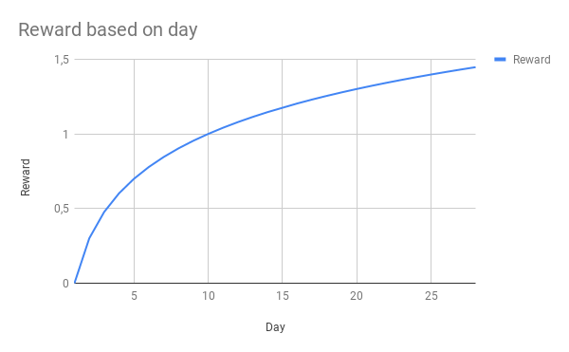
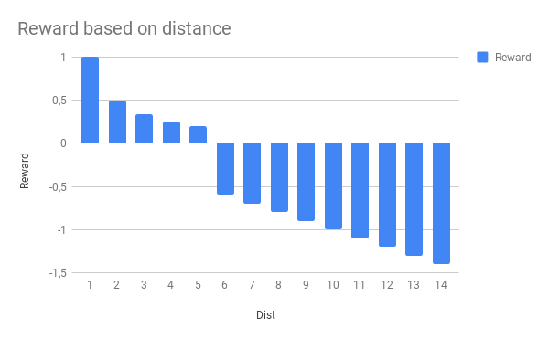
Reward Functions
For dist=1;
For day=1;
Notes:
dist represents the distance relative to the agent chosen interval prediction and the user historical data interval,

Slide 14

Case Study

Slide 15
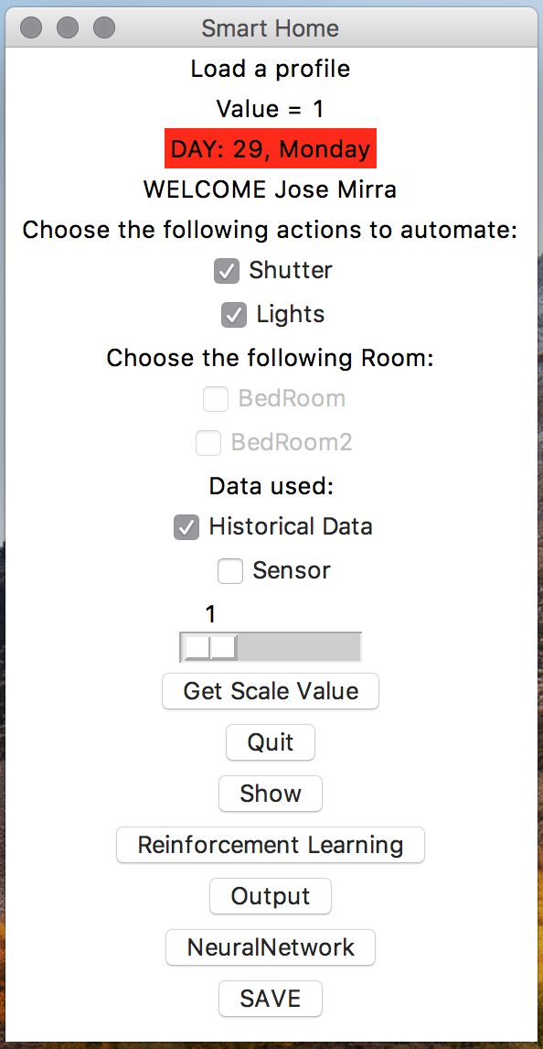
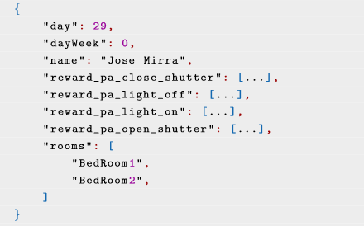
Application Developed
User Profiles are created and loaded in the application:
Historical Data is simulated by a script to each Room.

Slide 16


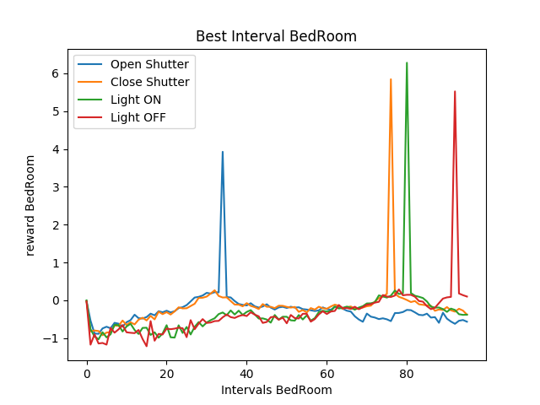
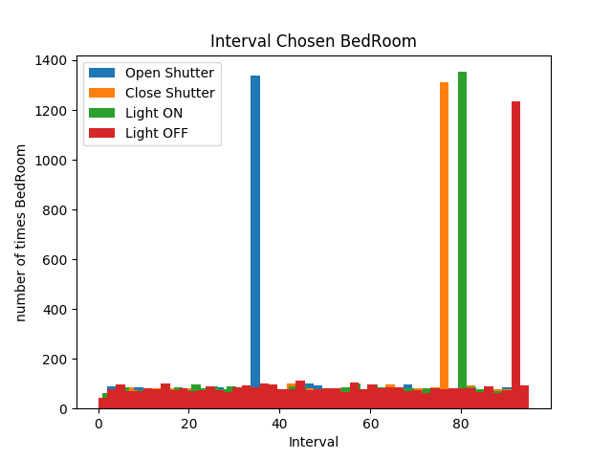
Results (Room 1)
23:45H
Notes:
ROOM 1. Room 1 is inhabited by a day laborer. that the agent inclines signiﬁcant more to a determinate interval than others, when considering the action. This is caused by the neural network prediction.

Slide 17
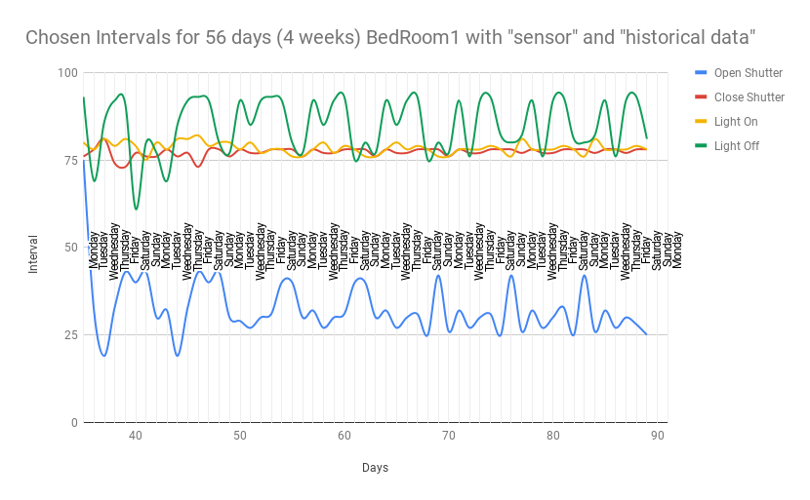
Results
Notes:
2 months of the same lifestyle.
It’s expected to predict the same intervals as before to every action as the model we are using is pre-trained with approval of the end-user, as it has more data and feedback helping his decision.

Slide 18

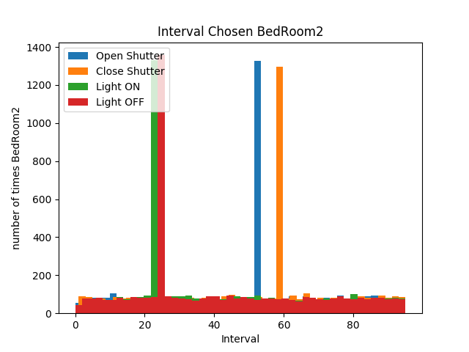
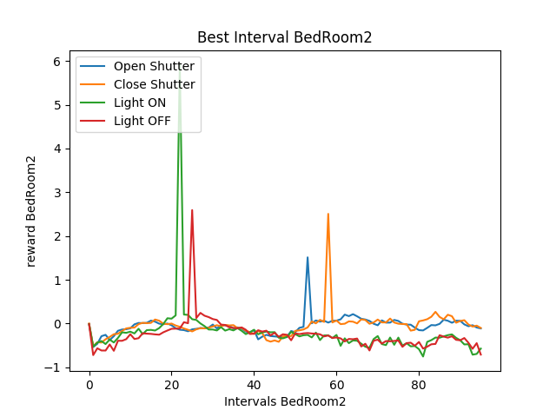
Results (Room 2)
Notes:
ROOM 1. Room 2 is inhabited by a NIGHT laborer. that the agent inclines signiﬁcant more to a determinate interval than others, when considering the action. This is caused by the neural network prediction.

Slide 19
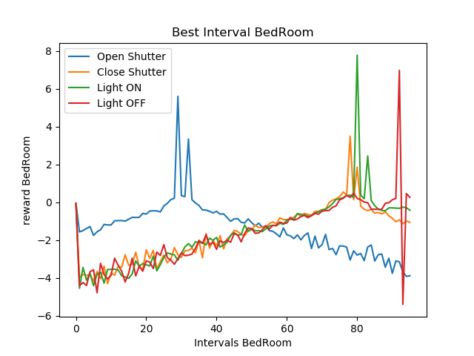


Results
Represents the updated rewards after the user disagrees with the system decision on turning the light off in Room 1.
23:45H
23:30H
Notes:
ROOM 1. Room 1 After user feedback,
After user disagrees with light OFF at 23:00H (interval 91). Algorithm selects 23:45H (94)

Slide 20
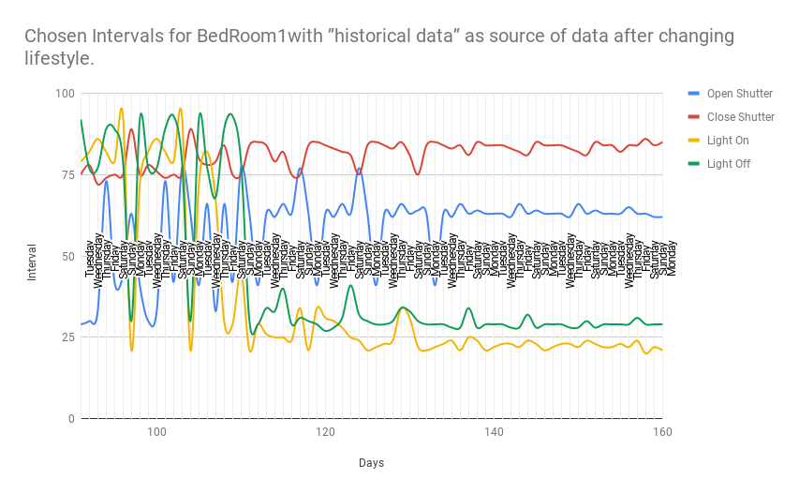
Results

Slide 21
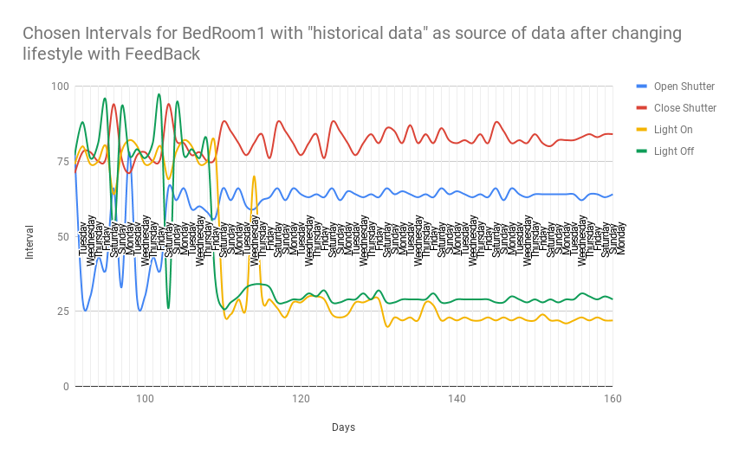
Results
Notes:
We can observe the differences with and without user feedback. The learning process is substantially faster, as the system receives an extra hint when deciding.

Slide 22

Conclusion

Slide 23
Conclusion
Unlike the previous reinforcement learning approaches, this project highlights the role of the inhabitant to combat the social impasses of Smart Homes.
The system was tested based on its ability to predict the best 15 minute interval present in day for lights and blinds in different rooms present in a home.
User Feedback was also been tested and it demonstrates how inﬂuential it is upon the system.
Publication of a scientific article, which was presented in Rome at the conference IE’18: The 14th International Conference on Intelligent Environments - IE ’18 Rome 25th-28th June 2018, in the Citizen-Centric Smart Cities Services (CCSCS’2018) workshop.
Notes:
Has mention before, real data captured by different IoT devices present in a smart environment are not currently available. We simulated the data

Slide 24

Future Work

Slide 25
Future Work
Increase the complexity of the reward functions, being more dependent of the user feedback and environment sensing.
Improve the system capability of gathering feedback by improving the Interface and the feedback process.
Fully integration with Application programming interfaces (API’s) are planned, allowing this system to not be restricted to sensors to perceive the environment.
Extend the model to others environments, either public or private.
Testing our system to a real environment, without simulated data.
Notes:
No more +1 or -1 (rewards). Vary depending by how much it failed. If it failed >5 intervals, NEGATIVE Reward/dist
More weight to Recent days in historical.

Slide 26
Enhance Smart Home capabilities by learning from usage patterns and IoT devices José Alexandre Da Silva Mirra
Supervised by: Cesar Analide and Fábio Silva December 2018

